Slide 1
CS 201 – DATA STRUCTURES
LECTURE 08 & 09 - RECURSION

Slide 2
Introduction
Why recursion?
Function A calling itself
Or function A calling another function B that in turn calls function A.

Slide 3
Properties
Two main properties to remember for constructing recursive function
Base case
Progression

Slide 4
Working of recursion
Stack frame – our activation record
keeps the information about local variables, formal parameters, return address and all information passed to the caller function

Slide 5
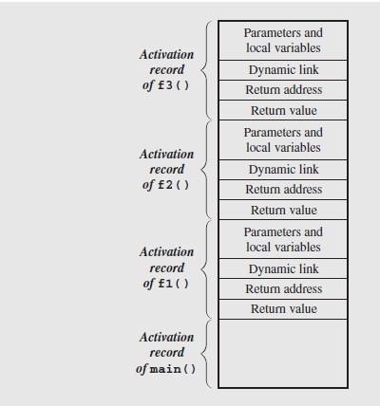
Stack frame view

Slide 6
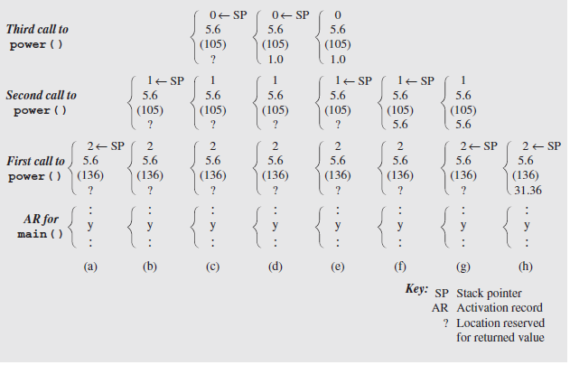
Stack frame in-depth view

Slide 7
Tail recursion
when recursive call is the last thing executed by the function
since the recursive call is the last statement, there is nothing left to do in the current function, so saving the current function’s stack frame is of no use
Memory savage

Slide 8
Non tail recursion example
Factorial(int n){
if (n == 0) return 1;
return n*fact(n-1);
}

Slide 9
Tail recursion example
factorial( int n, int a)
{
if (n == 0)
return a;
return factorial(n-1, n*a);
}

Slide 10
Excessive recursion
Some recursive methods repeat the computation for some parameters
Results in long computation time even for simple cases

Slide 11
Fibonacci – non tail recursion
function fib1(n){
if n = 0 then
return 0
else if n = 1 then
return 1
else
return fib1(n - 1) + fib1(n - 2)

Slide 12
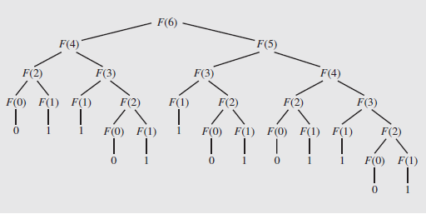
Problem associated with Fibonacci

Slide 13
Repetition of same calculation being done as system forgets what has been calculated before.
New algorithm for Fibonacci which has memorization – an optimization technique also called as recursion with memoization approach.

Slide 14
Fibonacci - Tail recursion
int fib ( int n , int next, int result)
{
if (n == 0)
return result;
return fib(n - 1, next + result, next);
}
Start off with Fib(n,1,0) keeping next =1 and result =0

Slide 15
Tower of Hanoi
void towerOfHanoi(n, source, dest, aux) {
if n == 1, THEN
move n from source to dest
else
Hanoi(n - 1, source, aux, dest)
move n from source to dest
Hanoi(n - 1, aux, dest, source)
}
int main() {
int n = 3; // Number of disks
towerOfHanoi(n, 'A', 'C', 'B');
return 0;
}

Slide 16
Indirect recursion
A function calling itself via chain of other calls
Eg proxy-server

Slide 17
Nested recursion
When a recursive function call has itself as the parameter

Slide 18
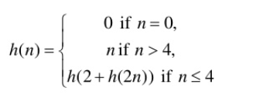
Nested recursion example

Slide 19
Binary recursion
Some recursive functions don't just have one call to themselves, they have two (or more).
Functions with two recursive calls are referred to as binary recursive functions.

Slide 20
Backtracking
Make a decision when you have various choices.
Start from a point, look for a solution, if not satisfied, return back, find next path to explore.
Eg Sudoku, 8 queens problem

Slide 21
Flaw in recursion
Slow execution time
Storing on run-time stack more things than required in non recursive approach

